Slide 1
APIs Everywhere Jamstack
March 2019
Berkeley Javascript dojo
meetup

Slide 2

Welcome to BJD find us here
Twitter
@JavascriptDojo
Join us on Slack

Slide 3
What is it?
“J” = Javascript, handles all dynamic programming running on client
“A” = api, server-side and database abstracted into reusable apis
“m” = markup, templated markup built with ssg or build tool (i.e. hugo, webpack)
“stack” = technology stack

Slide 4
Breakdown
Static site generator (SSg)
Hosting or cdn
postman
Go template language
Javascript
Graphql
Headless content management systems

Slide 5


Static site generator (ssg)
Jekyll…
most popular, lots of plugins
Gatsby and next… react
Nuxt and grisdome… vue
Pelican and mkdocs… python
Middleman and nanoc… ruby
Hugo and inkpaper… go
Wyam and pretzel… .net

Slide 6
Ssg - decisions
Pros
Fast load times
Security and reliability
Flexible
Cons
Content management
Administrative tasks
Dynamic features

Slide 7




Cdn or hosting services
Netlify
Github pages
zeit

Slide 8

postman
Test api connections

Slide 9
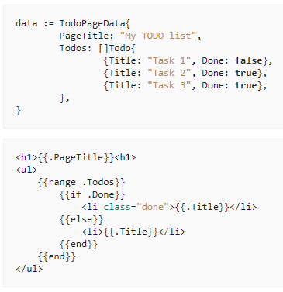
Go template language

Slide 10

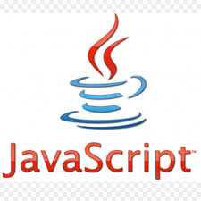
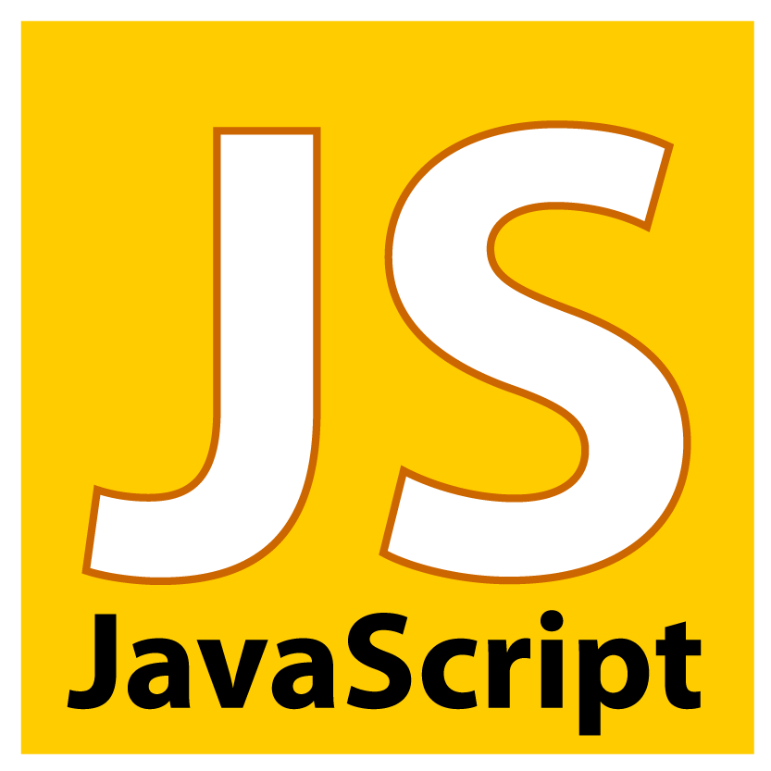

javascript

Slide 11

graphql
Decouple apis with abstraction using graphql

Slide 12
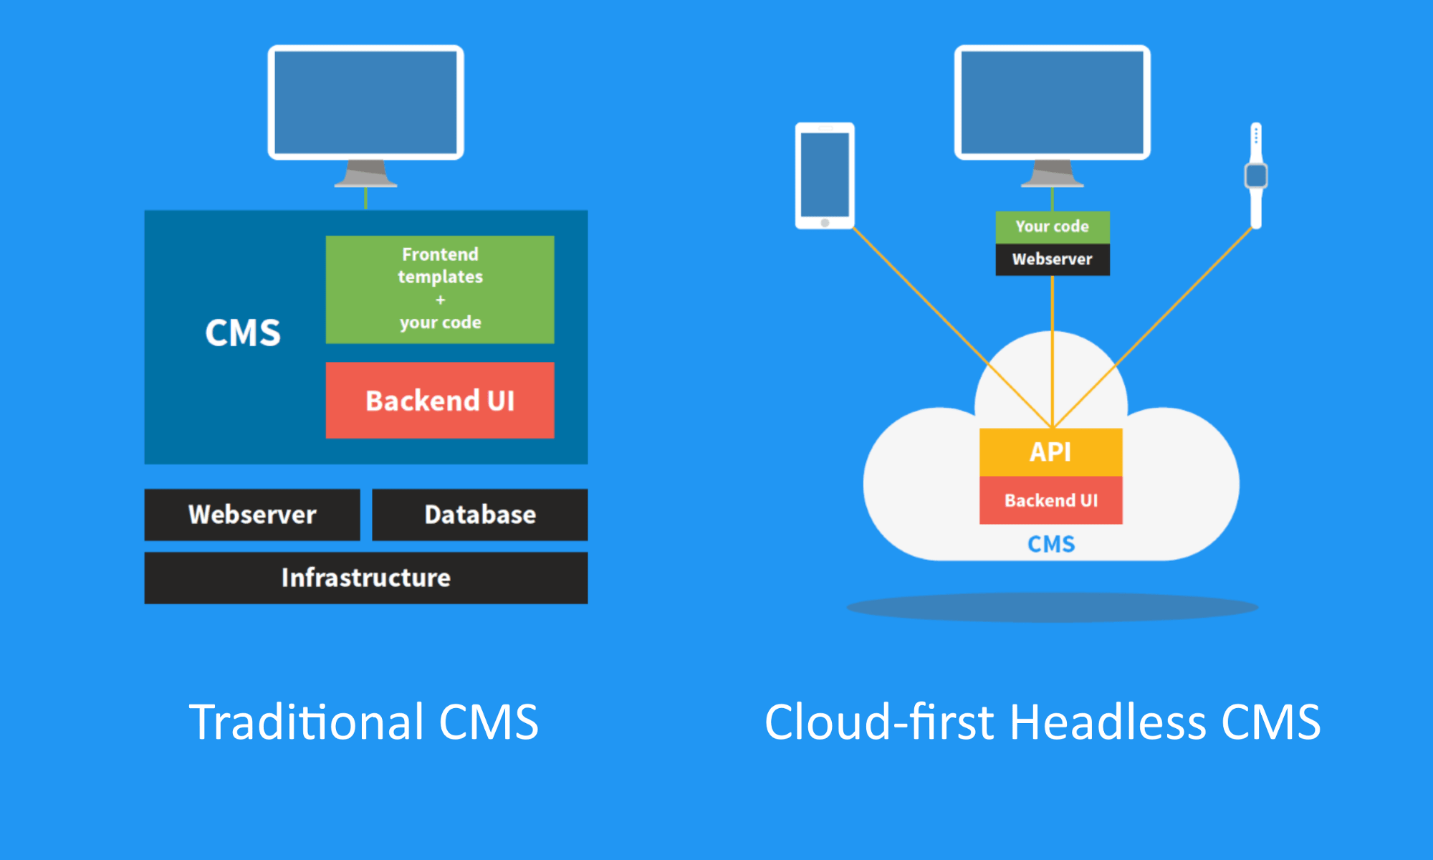
Headless content management systems
Restful api access to your wordpress or other cms
Manage user permissions
Manage editor roles
Manage content

